Slide 1
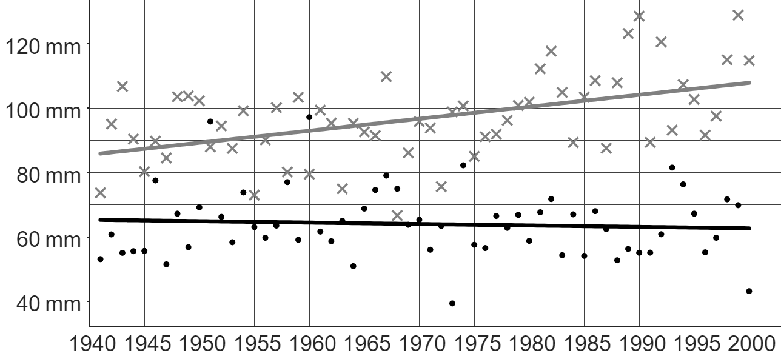
Studying local climate change
Task A: Analysing local climate data
1) This graph from the Met Office shows the average monthly rainfall (in mm) each year from 1941 to 2000 in Stornoway and Southampton.
Key:
Stornoway
Southampton
Andeep says: “We usually expect to see more rain falling each month in Stornoway than in Southampton.”
a) Explain how Andeep might have come to this conclusion.
b) In 1968, more rain fell in Southampton than in Stornoway. Explain whether this makes Andeep’s claim incorrect or not.
The trendline for Stornoway is above the trendline for Southampton. This means there is a trend of Stornoway having a larger amount of rainfall than Southampton.
Andeep is correct. The trend is definitely that Stornoway has more rainfall than Southampton. A few years that do not fit this trend does not mean the trend isn’t true across a longer timeframe.
Sofia says: “Over time, the general trend in Stornoway is that the average amount of rainfall is increasing.”
c) Sofia is correct. Explain how Sofia might have come to this conclusion.
d) Write a sentence describing the long-term trend of Southampton’s rainfall.
Stornoway’s trendline has a positive gradient (the line is going up from left to right).
Over time, the general trend in Southampton is that the average amount of rainfall is very slightly decreasing over time.
Alternative response: The average amount of rainfall is staying fairly constant over time.
Izzy says: “Stornoway is in Scotland. That means the amount of rainfall in other parts of Scotland is also increasing over time.”
e) Explain whether Izzy’s statement is correct or not.
It is not sensible to generalise conclusions about one location to other locations, even within the same country. There are several reasons for this, such as Stornoway’s proximity to the sea, compared to other parts of Scotland.

Slide 2
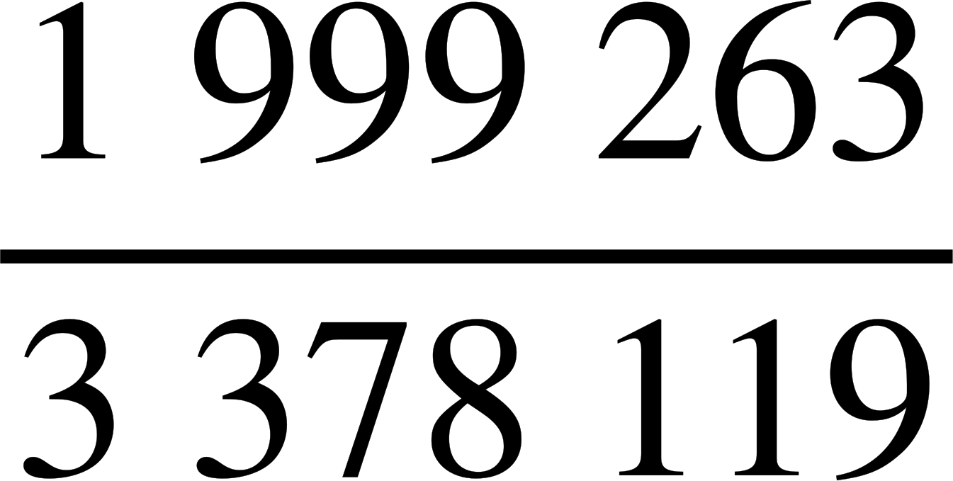
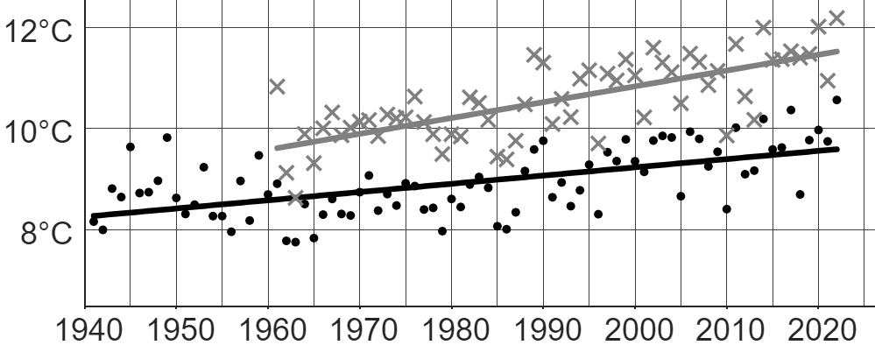
Studying local climate change
Task B: Forming conclusions about local climate change
1) This table from the ONS shows the distance people in the North-East and South-East of England travelled to work each day in 2011.
 | distance (d), in km
 | d < 2 | 2 ≤ d < 5 | 5 ≤ d < 10 | 10 ≤ d < 20 | 20 ≤ d < 30 | 30 ≤ d < 40 | 40 ≤ d < 60 | d ≥ 60
North East | 202 172 | 235 849 | 220 617 | 192 451 | 55 976 | 20 205 | 15 795 | 33 880
South East | 706 167 | 688 146 | 604 950 | 582 465 | 301 705 | 156 951 | 168 384 | 169 351
a) How many people’s information from the North-East were collected for this survey?
b) What fraction of people in the South-East travel under 10 km each day to work?
c) One possible influence on the climate of an area is the amount of carbon emissions (linked with travelling longer distances).
In which location (North-East or South-East) does a higher percentage of people travel 20 km or further each day to work?
976 945 people
North-East: 12.9% (to 1 d.p.)
South-East: 23.6% (to 1 d.p.)
A larger percentage of people in the South-East travel 20 km or further.
2) This graph shows data from the Met Office on the mean yearly temperature for two UK locations: Manston (1961 – 2022) and Durham (1941 – 2022).
Key:
Manston (South-East England)
Durham (North-East England)
The long-term trends of both Manston and Durham are similar. Both locations show an increase in mean yearly temperature over time.
In which location is the mean yearly temperature increasing at the faster rate? Explain how you know.
Manston’s mean yearly temperature is increasing at a faster rate than Durham’s because Manston’s long-term trendline has a steeper gradient.
Note: Temperature increasing at a faster rate is due to the steepness of Manston’s trendline, not because the line itself is higher up than Durham’s.

Slide 3
Studying local climate change
3) This graph shows data from the Met Office on the mean yearly temperature for two UK locations: Manston (1961 – 2022) and Durham (1941 – 2022).
Key:
Manston (South-East England)
Durham (North-East England)
a) Using both your answers to question 1c and 2, write down a possible link between distance travelled to work and mean yearly temperature.
The link could be that locations where people travel longer distances to get to work (and the resultant higher carbon emissions) have temperatures that increase at a faster rate than locations where fewer people travel longer distances to get to work.
b) Explain the extent to which this link is accurate or not by assessing the validity of the comparisons across both sets of data.
Whilst both the table (question 1) and graph (question 2) show data from the South-East and North-East regions of England, the graph only shows data from one part of each region. Therefore, it may not be valid to generalise the conclusions we make about the rate of temperature increase from Manston and Durham to the rest of each region.
Positives that give validity to our comparisons include the timeframes. Both regions in the graph show data from 1961 to 2022 (with Durham having data going back to 1941), which allow for like comparisons between regions. Furthermore, the table from question 1 shows data collected in 2011, which is within the 1961 to 2022 timeframe.
Mathematics in Education and Industry
v2.4

